Slide 1
Introduction to Linux
Linux 1 Day 1

Slide 2
Class Objectives
By the end of class, you will be able to:
Name three of the most important Linux distributions.
Navigate the Linux file structure using the command line.
Manage processes with the top, ps, and kill commands.
Install packages using apt.

Slide 3

So, Why Linux?
Notes:
shutterstock_419292739

Slide 4

Why Linux
Over 70% of websites run some version of Unix.
w3techs.com
Notes:
shutterstock_596101424

Slide 5



Why Linux
Unix refers to Linux and “Linux-like” operating systems.
Notes:
shutterstock_419292739

Slide 6

Why Linux
The ubiquity of Linux machines on modern networks makes it a common target for attackers.
Notes:
shutterstock_534253945

Slide 7
Familiarity with the operating system is crucial for cybersecurity professionals.

Slide 8
Linux in a Professional Context
Knowledge is essential for the following technical roles, among others:
Help Desk / IT Support
System Administration
Penetration Testing
Network Forensics

Slide 9


Activity Scenario
Throughout today’s exercises, you will:
Investigate a malfunctioning Linux server reported to be running more slowly than usual. | Identify suspicious activity on the system and then contain it. | Methodology will include:
 |  | Auditing files
 |  | Auditing processes
 |  | Installing security packages
 |  | Configuring security services

Slide 10
Linux History and Distributions

Slide 11
A (very) Brief History of Linux
In 1969-1970, Dennis Ritchie, Kenneth Thompson and several others at AT&T Bell Labs began developing a small operating system called Unix.
Within the next two decades, different updates and distributions of Unix were created. Most were proprietary.
In 1984 Richard Stallman's Free Software Foundation (FSF) started the GNU project, which created a free distribution of the Unix operating system
In 1991, Linus Torvalds used many of the components from the GNU project to create a free, open source operating system, which is now known as Linux.

Slide 12

An operating system (OS) is the software that supports a computer's basic functions, such as scheduling tasks, executing applications, and controlling peripherals

Slide 13

An Introduction to Linux
Windows, Mac OS X, and Linux are all examples of operating systems.
Notes:
shutterstock_419292739

Slide 14

By W3Cook's analysis of Alexa's data, 96.3% of the top one million web servers are running Linux. The remainder is split between Windows, 1.9%, and FreeBSD, 1.8%.
—Steven J. Vaughan-Nichols
zdnet.com
Notes:
Source: https://www.zdnet.com/article/can-the-internet-exist-without-linux/

Slide 15
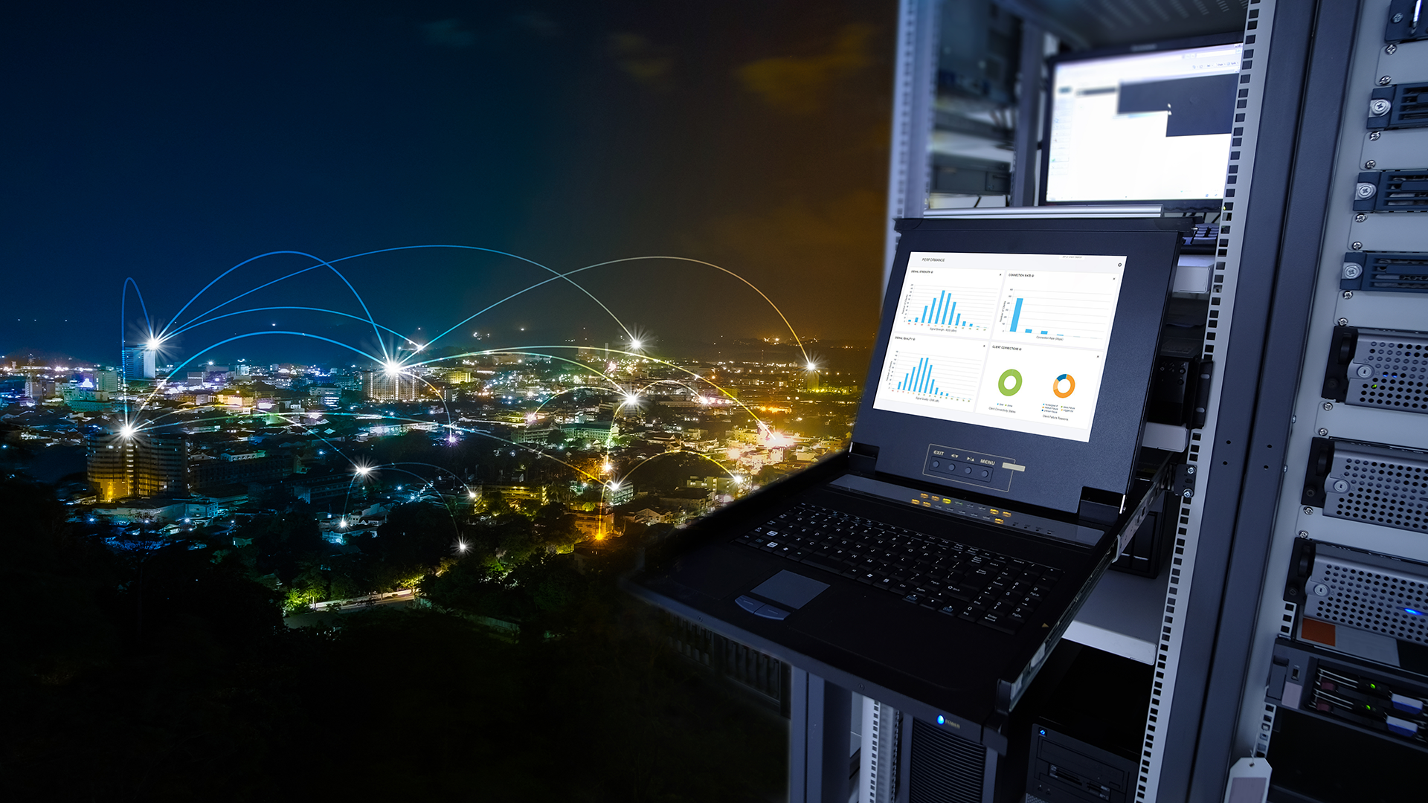
Most enterprise networks feature at least one Linux machine.
Notes:
shutterstock_732692350

Slide 16
Unlike Windows and OS X, Linux is free, open source software (FOSS).

Slide 17

Anyone can modify the source code.
Notes:
shutterstock_491237230

Slide 18
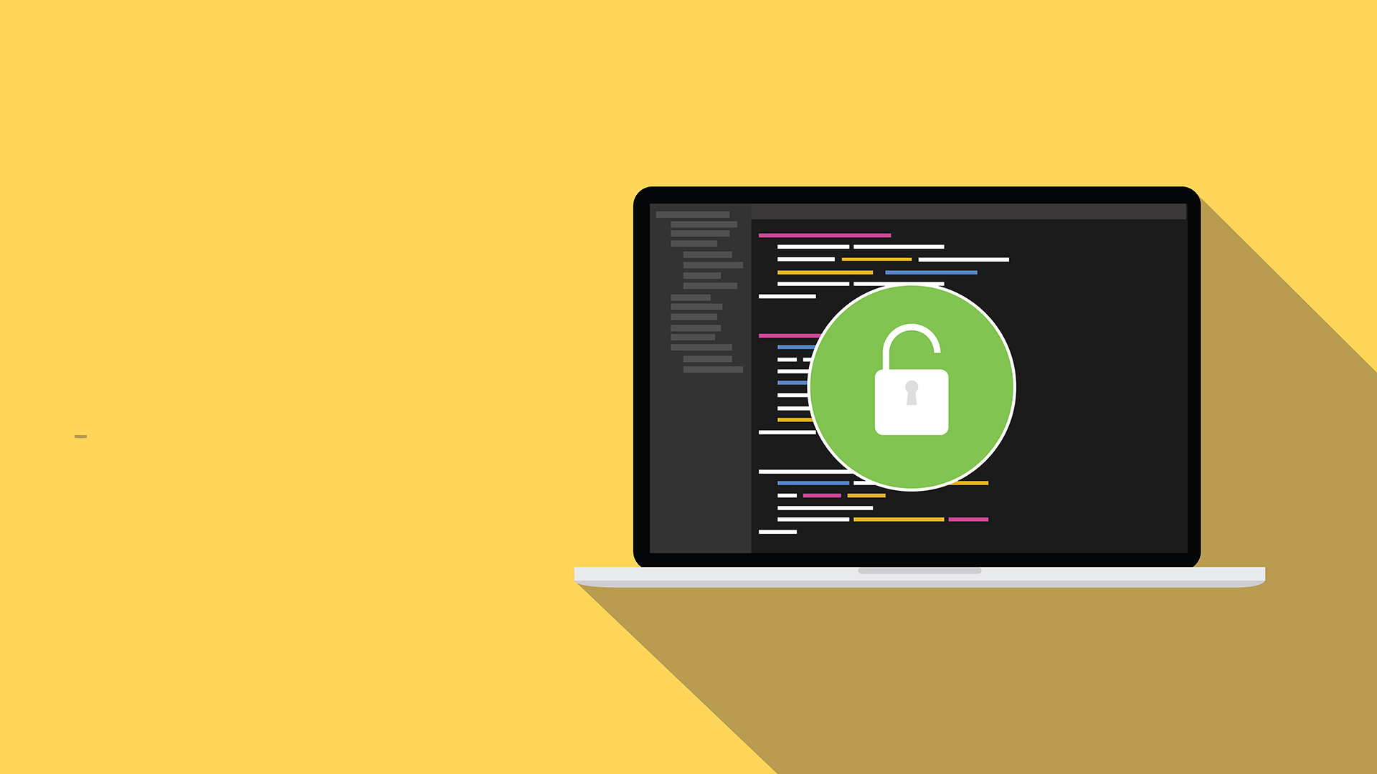
Most tools in the hacker / security community are still published as open-source.
Free software and information is prevalent in the industry. Almost all the tools we’ll use in class are open source.
Notes:
shutterstock_488480038

Slide 19
Distributions

Slide 20
Distributions are special-purpose variants of the operating system

Slide 21


Linux Distributions
In this course, we’ll use two distributions: Ubuntu and Kali Linux.
Ubuntu
Kali Linux
Ubuntu is geared towards general-purpose users.
Kali is designed specifically for security professionals.

Slide 22

Linux Distributions
Ubuntu and Kali Linux are both specialized distributions of Debian, which is itself a distribution.

Slide 23

Linux Servers
In order to conserve as many resources as possible, most production Linux servers don’t offer a graphical interface.
Therefore knowledge of the command-line is essential for understanding Linux.
Notes:
shutterstock_185734466

Slide 24

These command-line only machines are called
headless servers.
>_
Notes:
shutterstock_1202854222

Slide 25
Activity: Distribution Research
You are a system administrator at X Corp, which has recently experienced a number of breaches involving servers running outdated Linux distributions.
In response, the IT Department has decided to upgrade the affected servers with newer distributions of Linux.
You must conduct research to determine which distribution is most appropriate for each machine.
15 Minutes

Slide 27
Distribution Research Review
Identify which distribution(s) is most appropriate for each situation.
Central Data Server
Public Web Server
IT Audit Workstation
User Workstation

Slide 28
Distribution Research Review
Identify which distribution(s) is most appropriate for each situation.
Central Data Server | Stores sensitive human resources data, so should use a secure distribution. Fedora and CentOS use SELinux by default, making them good choices.
Public Web Server
IT Audit Workstation
User Workstation

Slide 29
Distribution Research Review
Identify which distribution(s) is most appropriate for each situation.
Central Data Server | Stores sensitive human resources data, so should use a secure distribution. Fedora and CentOS use SELinux by default, making them good choices.
Public Web Server
IT Audit Workstation
User Workstation

Slide 30
Distribution Research Review
Identify which distribution(s) is most appropriate for each situation.
Central Data Server | Stores sensitive human resources data, so should use a secure distribution. Fedora and CentOS use SELinux by default, making them good choices.
Public Web Server | Needs to run quickly and handle large amounts of traffic. Many distributions could work, but Ubuntu and Fedora are among the best choices because they are well-supported.
IT Audit Workstation
User Workstation

Slide 31
Distribution Research Review
Identify which distribution(s) is most appropriate for each situation.
Central Data Server | Stores sensitive human resources data, so should use a secure distribution. Fedora and CentOS use SELinux by default, making them good choices.
Public Web Server | Needs to run quickly and handle large amounts of traffic. Many distributions could work, but Ubuntu and Fedora are among the best choices because they are well-supported.
IT Audit Workstation
User Workstation

Slide 32
Distribution Research Review
Identify which distribution(s) is most appropriate for each situation.
Central Data Server | Stores sensitive human resources data, so should use a secure distribution. Fedora and CentOS use SELinux by default, making them good choices.
Public Web Server | Needs to run quickly and handle large amounts of traffic. Many distributions could work, but Ubuntu and Fedora are among the best choices because they are well-supported.
IT Audit Workstation | Should use Kali Linux, because it specifically designed for performing security assessments.
User Workstation

Slide 33
Distribution Research Review
Identify which distribution(s) is most appropriate for each situation.
Central Data Server | Stores sensitive human resources data, so should use a secure distribution. Fedora and CentOS use SELinux by default, making them good choices.
Public Web Server | Needs to run quickly and handle large amounts of traffic. Many distributions could work, but Ubuntu and Fedora are among the best choices because they are well-supported.
IT Audit Workstation | Should use Kali Linux, because it specifically designed for performing security assessments.
User Workstation

Slide 34
Distribution Research Review
Identify which distribution(s) is most appropriate for each situation.
Central Data Server | Stores sensitive human resources data, so should use a secure distribution. Fedora and CentOS use SELinux by default, making them good choices.
Public Web Server | Needs to run quickly and handle large amounts of traffic. Many distributions could work, but Ubuntu and Fedora are among the best choices because they are well-supported.
IT Audit Workstation | Should use Kali Linux, because it specifically designed for performing security assessments.
User Workstation | Should use Ubuntu, which comes with a GUI and basic productivity software, such as an email client, web browser, and text editor.

Slide 35

Which distribution is most flexible and best suited for day-to-day and administrative tasks?

Slide 36
Answer

Slide 37
Which distribution is built specifically for penetration testers?

Slide 38
Answer

Slide 39
Which distribution would you use to set up a web or data server?

Slide 40
Answer
Any will work, but Ubuntu Server and Fedora Server both have easy-to-configure web services.
You could use Debian or CentOS for more manual tasks.

Slide 41
What is the most widely-used Linux desktop environment?

Slide 42
Answer

Slide 43
What is a headless server?

Slide 44
A command-line only server, without a desktop environment.
Answer
>_
Notes:
shutterstock_1202854222

Slide 45
Does Ubuntu have a headless server type? Does Fedora? CentOS?

Slide 46
Yes, all three distributions provide a headless server type.
Answer
>_
Notes:
shutterstock_1202854222

Slide 47
Which distribution is Ubuntu based on? What about Kali?

Slide 48
Answer
They are both based on Debian.

Slide 49
Which distribution is CentOS based on? What about Fedora?

Slide 50

Answer
Both distributions are based on RedHat.

Slide 51
What is SELinux?

Slide 52





What is SELinux?
SELinux is a built-in file permission security enhancement developed by the NSA. CentOS and Fedora have it implemented by default.
Subject
(eg: a process)
Action Request
(eg: read)
SELinux Security Server
Permission Granted?
Object
(eg: a file)
Yes
No
SELinux
Policy Database
AVC Denied Message

Slide 53
You are deciding between versions of Ubuntu Servers. If you want a version that will remain stable over time, which version do you choose?

Slide 54
Ubuntu Server Versions
You would want to choose the “Long Term Support” (LTS) version. The latest version will have continual updates and changes. The LTS version will remain stable and only change approximately once a year.

Slide 55
What are some security implications of using free and open source software or forks of popular Linux distributions?

Slide 56

As demonstrated in the Mint OS article, open source means that anyone can contribute. Therefore, a hacker with programming skills will be able to attack somewhat easily. You must be vigilant of where you download your software.
Notes:
shutterstock_491237230

Slide 57
Linux File System Structure

Slide 58
Linux File System Structure
Each OS maintains certain conventions for where and how they store different kinds of files. For example, Windows and Mac machines typically place images in a ~/Pictures folder.
Linux also has a conventional file system structure.
These conventions are consistent across distributions. For example, user applications are typically stored in /usr/bin, and this will always be the case across distributions.
Therefore, we can apply what they learn today to other distributions we encounter, since each distribution will have the files and folders that we will learn about today.
In addition, all popular Linux distributions use the bash shell by default. This means we can use the command line tools they learn here on other distros, as well.

Slide 59
File Systems
Linux maintains certain conventions for storing files:
/ (root) | The root directory that contains every other directory.
/home | Contains users’ private file. Users should not be able to save files elsewhere.
/etc | Contains configuration files, defining how a machine runs and who can use it.
/bin, /sbin | Contain applications such as web browsers and commands like ls.
/var | Contains files that change over time.
/tmp | Contains files that are only needed for a short period of time.

Slide 60

Demo Scenario
Let’s launch a terminal an walk through the Linux file system, starting at the top of the directory structure, the Root Directory.
Notes:
shutterstock_1361601656

Slide 61
Navigating Linux File Structures

Slide 62
Demo Takeaways
The audit took us to the following directories:
/etc | Stores specific, system-wide configuration files, as well as the most sensitive files on a Linux system.
/var | Stores files that are continually updated.
/home | Stores user home folders.
/tmp | Where applications write temporary files that can be deleted on reboot.
/bin and /sbin | Where the system keeps its main binary or program files.

Slide 63
Activity: Linux Landmarks
Most technical roles in cybersecurity require comfort with the command line and familiarity with the structure of a Linux file system.
You will use this knowledge to navigate file systems when looking for suspicious activity or administering the machine.
The next exercise will give you an opportunity to explore the file system and practice using the command-line.
30 Minutes

Slide 66
Resources and Processes

Slide 67
Introduction to Processes
When a program runs, it must process data and potentially make changes to the file system. This is why we call a running program a process.
When these programs process, save and modify data, they consume a computer’s resources.
Let’s take a look at two of the most important resources: memory and the CPU.

Slide 68
Memory is the space used by a process to save and manipulate data.

Slide 69
Memory
Memory comes in two forms:
RAM
Disk Space
Random Access Memory (RAM) is used to run the program’s code. RAM is only used while the program is running.
The more work a process does, the more RAM it needs.
Disk space is used to save data permanently.
Files saved to a disk persist even after a process ends.

Slide 70
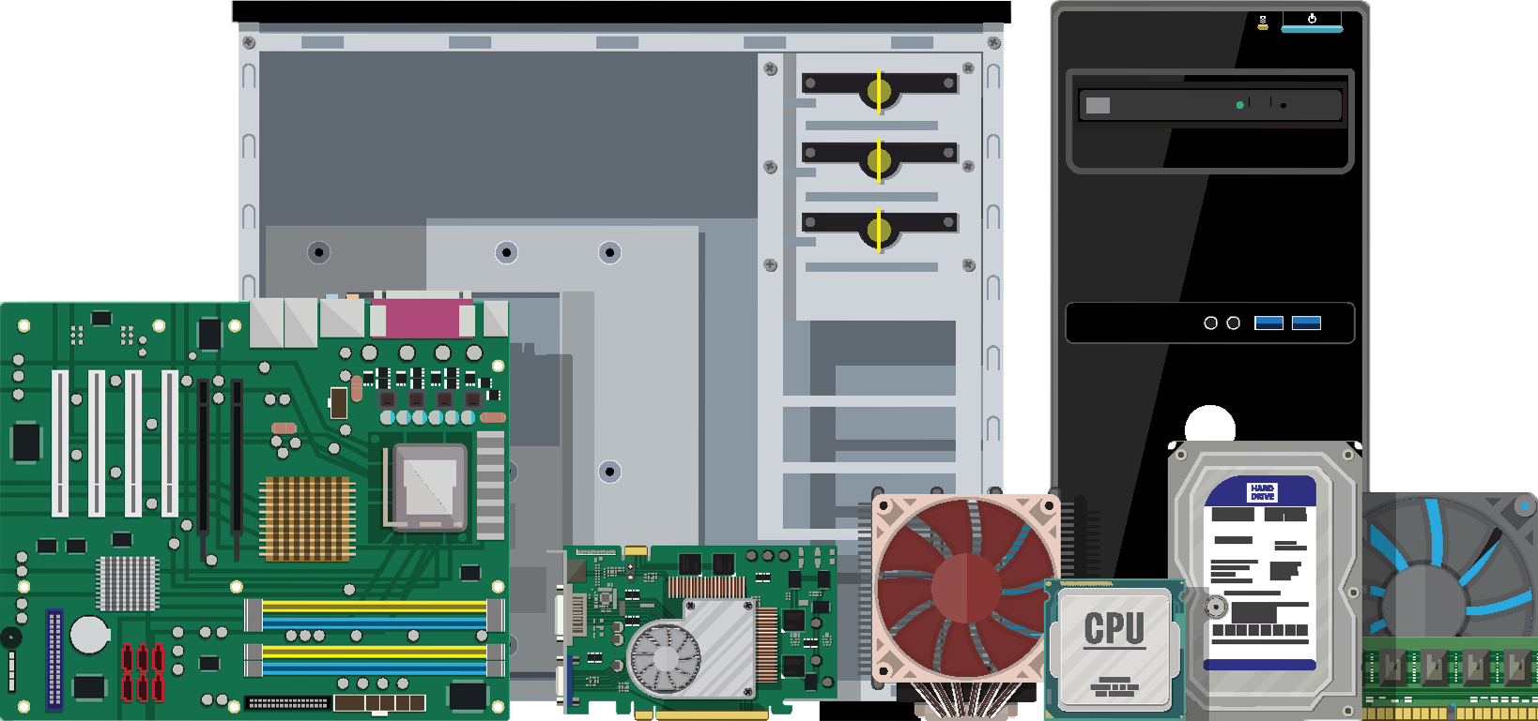
The Central Processing Unit (CPU)
The Central Processing Unit (CPU) acts as the brain of the system, determining how much work a process has to do, and how difficult that work is.
A difficult task, such as encrypting a large file, will use a lot of RAM and/or CPU.
Easier tasks, like executing the ls command, will require only minimal RAM and/or CPU.

Slide 71
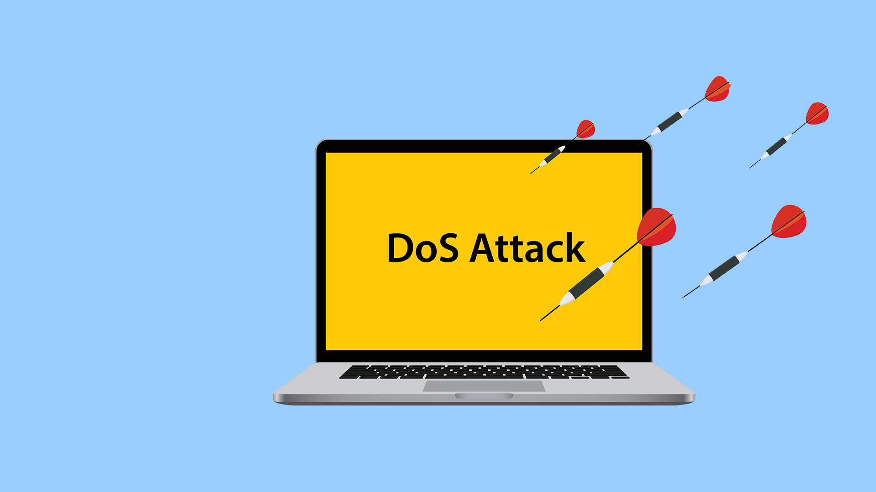
Targeting Resources
Hackers can take advantage of a system’s finite resources.
Hackers can perform denial of service (DoS) attacks by launching processes that eat up memory on a target machine.
This can slow down or crash the machine, making it unavailable to users, thus denying them service.
Notes:
shutterstock_399143986

Slide 72

Targeting Resources
Hackers can also start malicious processes that don't use a lot of memory, and are therefore difficult to spot without specifically looking for them.
One example is a backdoor process. This allows hackers to break into machines undetected.
These don't use much memory because they make a network connection to the hacker's machine, then listen for instructions.

Slide 73
Managing Processes
Linux has several commands for managing processes:
top | Allows you to see all running processes in real time. It updates every three seconds to show what’s happening on the system.
ps | Allows you to take a snapshot of all the running processes on the system. Different arguments allow you to show different subsets of processes and use this output with other commands.
kill | Used to stop processes, usually ones causing problems. kill attempts to allow a process to finish before it shuts it down.

Slide 74
Dynamic analysis is the process of running a potentially malicious script and monitoring its effects.

Slide 75

Let’s run a potentially malicious script to determine how it affects system health.
Notes:
shutterstock_1204467562

Slide 76
Inspecting Malicious Files Demo

Slide 77
Activity: Processing Investigation
In this activity, you will monitor the system for processes that should not be running.
Your senior admin asked that you record snapshots of processes as well as review processes in real time.
If you notice anything amiss, kill the process and add your findings to the report.
25 Minutes

Slide 79
Installing Packages

Slide 80


Packages
Administrators often install additional software to properly harden the machine.
Linux offers downloadable tools called packages.
New packages are installed with a tool called package manager.
We’ll use the Ubuntu package manager, called aptitude. We will use aptitude with the command apt.
Notes:
shutterstock_1363031105

Slide 81

Packages
sudo apt install <package name>
Linux searches databases to find information about <package name>. If found, it will be downloaded.
These databases are known as repositories.
Repositories specifically used to store and distribute packages are known as Personal Package Archives, or PPAs.

Slide 82
Packages
Today, we’ll install the following packages.
lynis | Checks that a Linux machine is properly secured.
john | Verifies that users are using strong passwords.
chkrootkit | Scans machines for the presence of a malware called rootkit.
tripwire | Monitors the file system for suspicious changes.

Slide 83
(Take Home) Activity: Installing packages.
In this activity, you will install and configure
tripwire, chkrootkit, john, and lynis.
OYO

